Slide 1

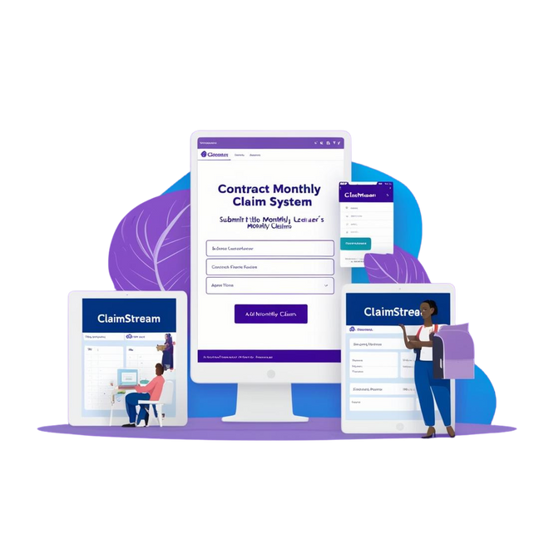
CAMERON CHETTY - ST10251759 - PROG6212 - POE
ClaimStream
Revolutionizing Claim Management for Academic Institutions
Notes:
Hi Fatima, hope you are well! This is a presentation discussing my final build for PROGRAMING 2B Portfolio of Evidence. I will be speaking about the value of the Contract Monthly Claims System and how it provides a solution to the problem. I will thereafter show a demo of my app running, with all the requirements of the POE brief that have been implemented.

Slide 2

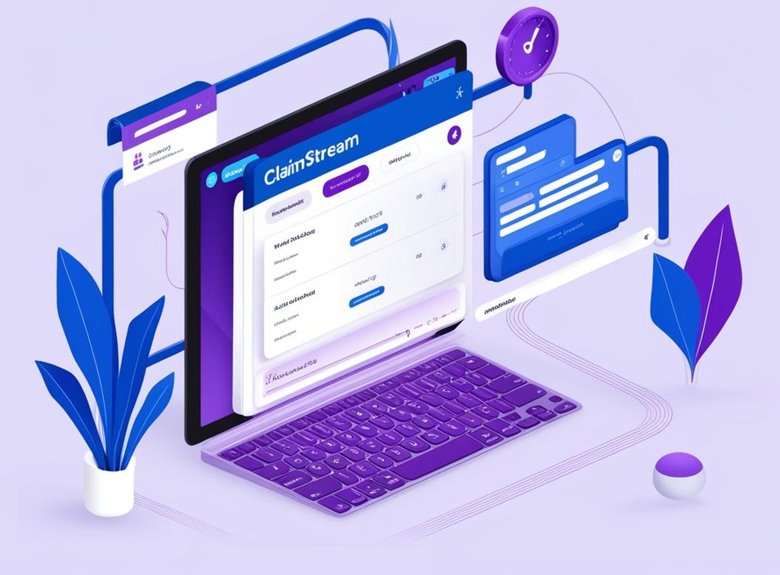
ST10251759 - CAMERON CHETTY - PROG6212 - POE
THE NEED FOR CMCS
Independent Contractor (IC) lecturers form a significant part of academic staff, contributing to teaching and learning processes. However, they typically work on a contract basis, requiring them to submit monthly claims for hours worked.
Problem Areas:
Independent Contractor (IC) lecturers often face tedious manual claim submission processes.
Claims must be verified and approved by multiple parties, increasing errors and delays.
Administrative inefficiencies affect productivity and user satisfaction.
Notes:
So firstly, let’s talk about the need for this system. Independent Contractor (IC) lecturers form a significant part of academic staff, contributing to teaching and learning processes. However, they typically work on a contract basis, requiring them to submit monthly claims for hours worked. With this stated, there are a couple problem areas within their current infrastructure, that result in the need for a management system.
Some of the Problems that’s exist could be:
Independent Contractor (IC) lecturers often face tedious manual claim submission processes.
Claims must be verified and approved by multiple parties, increasing errors and delays.
Administrative inefficiencies affect productivity and user satisfaction.

Slide 3

ST10251759 - CAMERON CHETTY - PROG6212 - POE
CHALLENGES IN CURRENT CLAIM PROCESSES
These are the challenges faced in the current process of submitting claims.
Current Challenges:
Complexity: IC lecturers are required to submit claims that include detailed calculations for hours worked, often involving overtime or varying hourly rates based on different teaching activities (e.g., lectures, tutorials, grading)
Approval Bottlenecks: Manual workflows lead to delays. Claims typically require approval from several stakeholders (Programme Coordinators, Academic Managers and HR Managers)
Error Prone: High likelihood of miscalculations or missing documentation.
Limited Transparency: Lecturers have no visibility into claim status.
Notes:
Looking at the claim process these are some of the current challenges imposed on users:
Complexity of Claims Calculation:
Manual Calculations: IC lecturers are required to submit claims that include detailed calculations for hours worked, often involving overtime or varying hourly rates based on different teaching activities (e.g., lectures, tutorials, grading).
Error-Prone Formula: These calculations can be easily miscalculated if the lecturer or administrative staff makes an error, leading to delays and potential under- or overpayment.
Approval Bottlenecks:
Multiple Approval Layers: Claims typically require approval from several stakeholders (Porgramme Coodrinators, Academic Managers and HR mANAGERS), leading to extended processing times.
Delays in Review: If one party is unavailable or overloaded, it can cause a chain reaction, delaying the approval process and pushing back payment timelines.
Lack of Prioritization: Urgent claims may not be given priority, causing lecturers to wait for longer periods before receiving payment.
High Likelihood of Errors:
Missing Documentation: Often, IC lecturers may forget to attach necessary documents (e.g., proof of hours, receipts, timesheets) or submit incomplete forms, causing rework or rejection of the claim.
Inaccurate Data Entry: Manual data entry into spreadsheets or forms can lead to errors, such as wrong hourly rates, incorrect hours worked, or missing claim details.
Limited Transparency:
No Real-Time Visibility: Lecturers submitting claims have little visibility into where their claim is in the approval process. Lack of status updates or notifications leaves lecturers uncertain and anxious about payment timelines.
Poor Communication: Lecturers may not know if their claims have been approved, rejected, or are still under review, causing frustration and a lack of trust in the system.

Slide 4
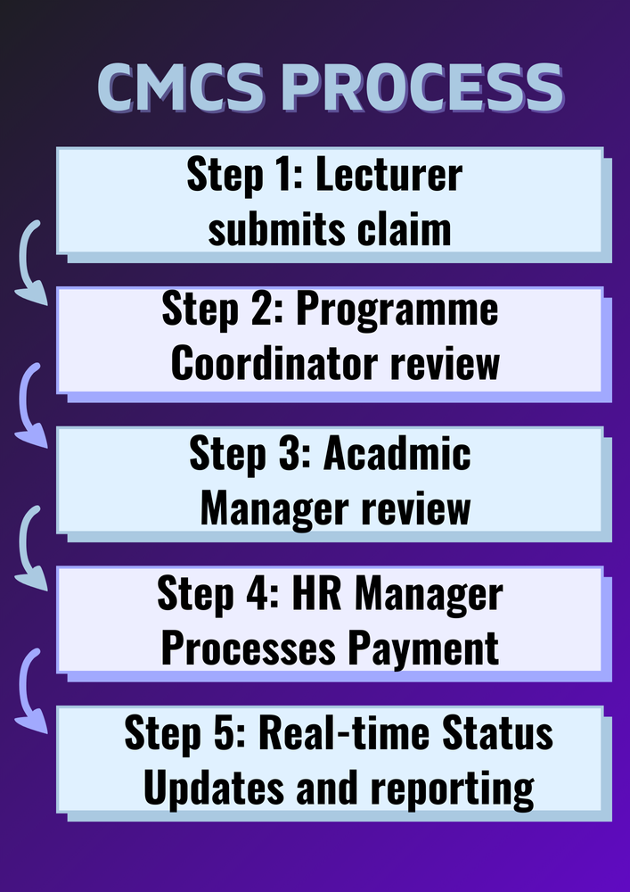
ST10251759 - CAMERON CHETTY - PROG6212 - POE
INTRODUCING THE CONTRACT MONTHLY CLAIM SYSTEM (CMCS)
ClaimStream solution provides the following functionality to address the need:
Automates claim submission, approval, and payment workflows.
Provides role-based access for lecturers, coordinators, managers, and HR.
Ensures accurate calculations and comprehensive validations.
Enables real-time claim status tracking and automated reporting.
Notes:
Now given the problems, this is how my solution of the app I developed, Claim Stream provides the functionality to address the issues:
ClaimStream automates claim submission, approval, and payment workflows.
Provides User management and role-based access for lecturers, program coordinators, academic managers, and HR managers.
Ensures accurate calculations and comprehensive validations to help maintain the accuracy of data captured in the system.
Enables real-time claim status tracking and automated reporting.
If you look to the diagram on your left you will see how the CMCS PROCESS is smooth and seamless, each step of procedure flows into the next, providing exceptional user-experience.

Slide 5


ST10251759 - CAMERON CHETTY - PROG6212 - POE
SYSTEM ASSUMPTIONS
These are the system assumptions for ClaimStream usage:
Claims Can Only Be Submitted for the Current or Previous Month:
Lecturers are restricted to submitting claims for the current month or the immediately preceding month. This ensures that claims are timely and relevant to the specified period.
Claims for future months are not allowed, to avoid delays or inaccuracies.
Hourly Rates Range Between R200 and R1000 for Up to 150 Hours per Month:
Lecturers can claim for any number of hours worked within this range. The system enforces these limits to ensure that claims remain within acceptable parameters.
The system checks if the claimed hours and rates are within the specified range (R200 - R1000 per hour for up to 150 hours), preventing erroneous submissions.
Proof of Hourly Rate and Contract Details Are Required:
To validate the claim, lecturers must provide proof of their agreed hourly rate and contract details. These supporting documents ensure that the claim aligns with the contract terms, reducing the risk of errors or fraudulent claims. Programme Coordinators and Acadmic Managers will review before processing claim.
The system verifies that these documents are uploaded before submitting the claim.
HR Processes Payments Using Third-Party Tools:
While the CMCS system tracks the claim process and marks claims as paid, payments are actually processed through third-party payment systems (e.g., bank transfers, online payment platforms).
The HR department updates the status in the system once payments are made, but no financial transactions take place within the application itself.
Notes:
With a system as complex as this, having assumptions serves as justification into the logic and functionality provided in this application. The assumptions made were used to enforce data validation, and help describe the environment and conditions of app usage.
These are the system assumptions for ClaimStream usage:
Claims Can Only Be Submitted for the Current or Previous Month:
Lecturers are restricted to submitting claims for the current month or the immediately preceding month. This ensures that claims are timely and relevant to the specified period.
Claims for future months are not allowed, to avoid delays or inaccuracies.
Hourly Rates Range Between R200 and R1000 for Up to 150 Hours per Month:
Lecturers can claim for any number of hours worked within this range. The system enforces these limits to ensure that claims remain within acceptable parameters.
The system checks if the claimed hours and rates are within the specified range (R200 - R1000 per hour for up to 150 hours), preventing erroneous submissions.
Proof of Hourly Rate and Contract Details Are Required:
To validate the claim, lecturers must provide proof of their agreed hourly rate and contract details. These supporting documents ensure that the claim aligns with the contract terms, reducing the risk of errors or fraudulent claims. Programme Coordinators and Acadmic Managers will review before processing claim.
The system verifies that these documents are uploaded before submitting the claim.
HR Processes Payments Using Third-Party Tools:
While the CMCS system tracks the claim process and marks claims as paid, payments are actually processed through third-party payment systems (e.g., bank transfers, online payment platforms).
The HR department updates the status in the system once payments are made, but no financial transactions take place within the application itself.

Slide 6


ST10251759 - CAMERON CHETTY - PROG6212 - POE
LOGIC AND FUNCTIONALITY
ClaimStream systems logic:
Lecturer Role: Submit claims, attach documents, and track status.
Coordinator Role: Review and approve/reject claims.
Manager Role: Final approval for claims.
HR Role: Process payments , User Management and generate automated reports.
Validation Logic: Ensures compliance with rules for claim periods, rates, and hours. Unit Tests for testing Classes and Models. Microsoft Identity with role-based access.
Notes:
ClaimStream provides usage for 4 types of users, namely Lecturers, Coordinators, Managers, and HR Managers. Each user will have their own menu of options and have their own functionality within the system.
The systems logic is as follows:
Lecturer Role: Submit claims, attach documents, and track status.
Coordinator Role: Review and approve/reject claims.
Manager Role: Final approval for claims.
HR Role: Process payments , User Management and generate automated reports.
Validation Logic: Ensures compliance with rules for claim periods, rates, and hours. Unit Tests for testing Classes and Models. Microsoft Identity with role-based access.

Slide 7

ST10251759 - CAMERON CHETTY - PROG6212 - POE
DEVELOPMENT JOURNEY - AGILE DEVELOPMENT PHASES
This application was developed using Agile methodologies and comprised of 3 sprints:
Sprint 1: Documentation, UML diagrams, and GUI wireframes. In this sprint, the focus on planning and designing the system, including creating documentation, UML diagrams for system architecture, and wireframes for the user interface.
Sprint 2: Initial prototype with core claim submission features. This sprint involves developing the initial prototype of the system, implementing the core functionality for claim submission, and testing basic workflows for lecturers to submit claims.
Sprint 3: Final build with automation, validation, and reporting. The final sprint focuses on refining the system, adding automation for approval and payment workflows, implementing validation for claims, and integrating reporting features for real-time tracking and analytics.
Part 1
Part 2
Part 3
Notes:
This application was developed using Agile methodologies and comprised of 3 sprints, each of with built of the previous part:
Sprint 1: Documentation, UML diagrams, and GUI wireframes. In this sprint, the focus on planning and designing the system, including creating documentation, UML diagrams for system architecture, and wireframes for the user interface.
Sprint 2: Initial prototype with core claim submission features. This sprint involves developing the initial prototype of the system, implementing the core functionality for claim submission, and testing basic workflows for lecturers to submit claims.
Sprint 3: Final build with automation, validation, and reporting. The final sprint focuses on refining the system, adding automation for approval and payment workflows, implementing validation for claims, and integrating reporting features for real-time tracking and analytics.

Slide 8









ST10251759 - CAMERON CHETTY - PROG6212 - POE
TECHNOLOGY STACK
Structure, Tools and Framework:
IDE: Vistual Studio
Front-end: ASP.NET Core MVC, jQuery for interactivity, Css, HTML.
Back-end: C#, Entity Framework for database operations.
Database: SQL Server with a preloaded backup file.
Validation: FluentValidation, Client and Server Side Validation, JavaScript, JQuery, and Data Attributes for error-free workflows.
Reports: PDF generation using ITextSharp for creating reports.
Notes:
In developing ClaimStream, these were the technologies utilized:
IDE: Vistual Studio
Front-end: ASP.NET Core MVC, jQuery for interactivity, Css, HTML.
Back-end: C#, Entity Framework for database operations.
Database: SQL Server with a preloaded backup file.
Validation: FluentValidation, Client and Server Side Validation, JavaScript, JQuery, and Data Attributes for error-free workflows.
Reports: PDF generation using ITextSharp for creating reports.

Slide 9

ClaimStream
APPLICATION DEMO
Notes:
Now that I covered the value of ClaimStream Solution, I going to show you a demonstration of my application fulfilling the required functionality in real-time.
When a user runs the application, they are presented the home screen with two buttons to login and register. A new user who wishes to register will be required to enter their details along with their email and password. The register page has FluentValidation in place to maintain data-accuracy. So, Data is validated to make sure it is not null, phone numbers must be in the format with country code specified. Emails are validated for the valid format. Password is validated for its length.
Test Credentials
First Name: Rakeen
Last Name: Ramdeen
Email: rakeenramdeen@gmail.com
Password: Password@123
Credentials for Testing with Different Roles
Lecturer
Username/Email: lecturer@gmail.com
Password: N*BkM,T(L9:Jm=HF
Programme Coordinator
Username/Email: coordinator@gmail.com
Password: NeeuBgyFlE,HB7Uj
Academic Manager
Username/Email: manager@gmail.com
Password: R4,yNZcyoh77*zkD
HR Manager
Username/Email: hrmanager@gmail.com
Password: QKmiyI7?c7W?VBrb
So once registered successfully and the user tries to log inthey will be taken to a default screen. So the basis of this app is that only HR Managers can grant and manage access of users. So if I log in as an HR Manager I can assign a role to this user.
-[logs in as an HR goes to User Management]
-Log in as new user, creates 2 Claims for October and November showing validation
-Approve and reject one claim as a Programme Coordinator
-Reject a claim as Academic Mamager
-Log in as lectuerer and resubmit the two claims.
-Approve both.
-Log back in as a lectuer and show status tracking
-Log in as HR MANAGER - Process payments
-Generate reports. Payment and Claim Report
-Hr Manage Users – Delete users and Update users.

Slide 10

CONCLUSION
CMCS: Transforming Claim Management
CMCS demonstrates innovation in managing lecturer claims efficiently.
Supports organizational productivity with user-friendly, automated solutions.
Lays the foundation for future digital transformation in administrative processes.
ST10251759 - CAMERON CHETTY - PROG6212 - POE
Notes:
Now that I have shown the demonstration and discussed my application, I just want to conclude this presentation highlighting how this app adds value.
This system demonstrates innovation in managing lecturer claims efficiently.
Supports organizational productivity with user-friendly, automated solutions.
Lays the foundation for future digital transformation in administrative processes.

Slide 11
ST10251759 - CAMERON CHETTY - PROG6212 - POE
THANK YOU
CLAIMSTREAM
Notes:
Thank you for watching my presentation, I hope this video provided detailed information behind all aspect of my application. You will find this power point attached in my GitHub repo. Have a nice day.

